Slide 1
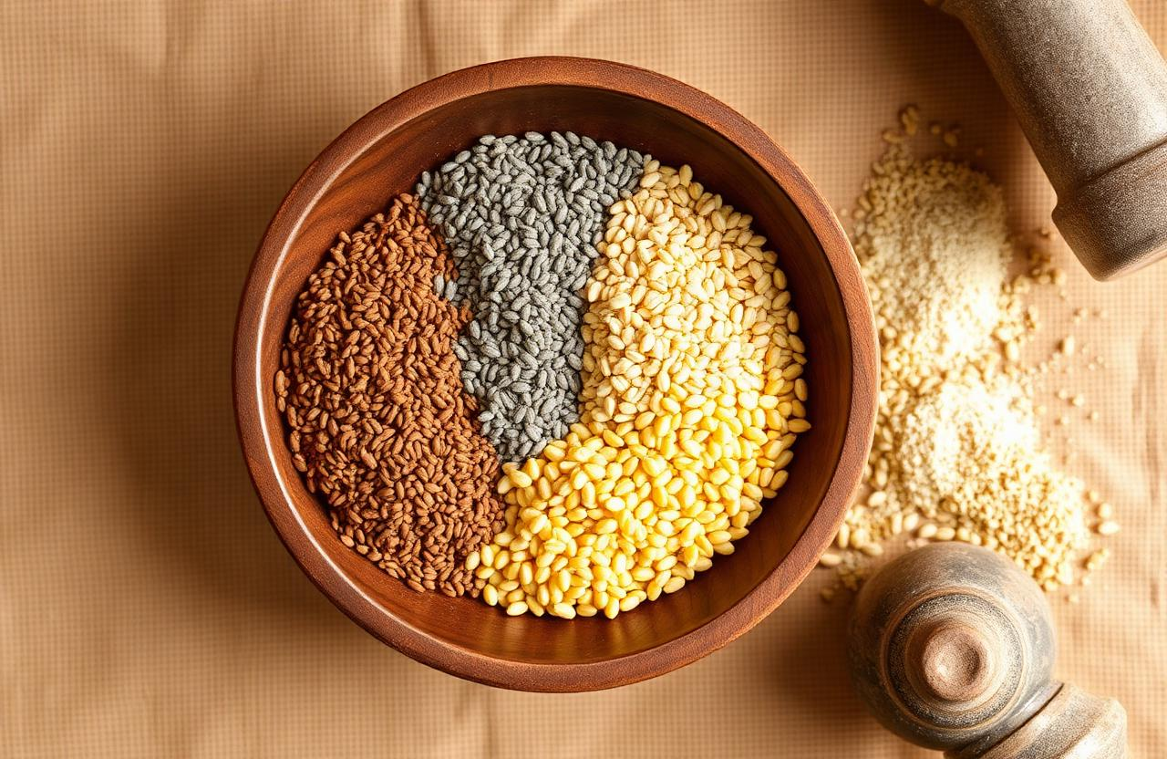
Nutri-Mix
Multi-Grain Flour
Ragi + Bajra + Maize
A nutrient-dense, economical flour
for health & livelihood.
Project by
Abdul Razak (B. Tech)
E tejaswini (PhD Scholar-Foods & Nutrition)
Dr. Ramagiri Praveen Kumar(Associate professor)

Slide 2
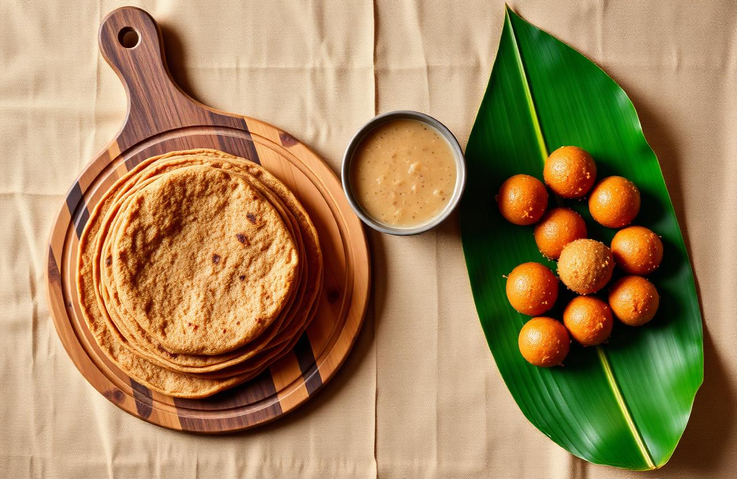
Why a Multi-Grain Flour?
Lifestyle diseases are rising — diabetes, anaemia, weak bones.
Single grains lack complete nutrition.
Solution → blend Ragi (Calcium) + Bajra (Protein & Iron) + Maize (Energy & Fibre)
Key benefits of the 50 : 30 : 20 blend (per 100 g)
Bone strength
Muscle growth
Digestive health
Anaemia care
186 mg
9.4 g
2.7 g
4.8 mg
one flour → many meals
Calcium
Protein
Fibre
Iron
50 : 30 : 20
Nutri-Mix • Ragi + Bajra + Maize (50:30:20)
2 / 10

Slide 3
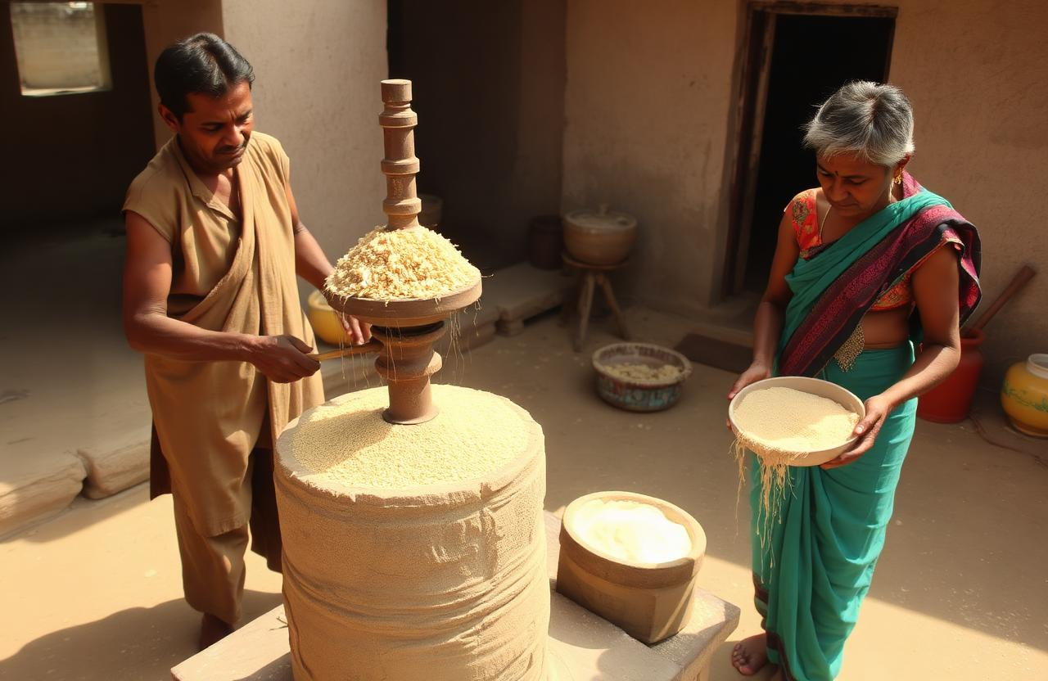
Team Details (Manpower)
Role | No. | Key Responsibility
Technical Person | 1 | Grain selection, grinding process, quality check
Non-technical (Labour) | 1 | Cleaning, drying, packaging, labeling
Total team size:
2 people per SHG unit
Training required:
2 days (mill + hygiene)
one feeds, one collects ✎
Nutri-Mix • Ragi + Bajra + Maize (50:30:20)
3 / 10

Slide 4
The Innovation — Nutritional Synergy
Three scientific principles we used:
1. Complete Protein
2. Calcium + Phosphorus
3. Fibre Synergy
Ragi → rich in Lysine (low Methionine)
Bajra & Maize → rich in Methionine
Together → complete protein (like animal sources)
Ragi → 344 mg Calcium
Bajra → 296 mg Phosphorus
Both needed for strong bones
Soluble fibre (Ragi)
+ Insoluble fibre (Maize, Bajra)
Prevents constipation without bloating
R ⟶ B ⟶ M = Complete Nutrition
Nutri-Mix • Ragi + Bajra + Maize (50:30:20)
4 / 10

Slide 5
Proposed Budget — 1 SHG Unit
Item | Cost (₹) | Type
Stone grinding mill (Chakki) | 25,000 | One-time
Weighing machine (×2) | 10,000 | One-time
Refrigerator | 30,000 | One-time
Airtight containers (×12) | 5,000 | One-time
Mixing bowls & sieves | 5,000 | One-time
Raw material (per kg flour)* | 65 – 85 | Monthly
Grinding charges (per kg) | 20 – 30 | Monthly
Total initial setup
≈ ₹ 75,000
one-time investment
Monthly operational
≈ ₹ 3,000
recurring cost
* Ragi 500 g • Bajra 300 g • Maize 200 g
Yellow = one-time • Green = monthly
Nutri-Mix • Ragi + Bajra + Maize (50:30:20)
5 / 10

Slide 6
Business Strategy
Target Customers
Pricing Strategy
Households with kids & elderly
New mothers (bone health)
Fitness conscious
Local kirana stores
Cost to make 1 kg flour: ₹ 135 – 195
Retail price: ₹ 220 – 250 / kg
Bulk to SHG federations: ₹ 180 – 200 / kg
Distribution Channels
Zero-Cost Marketing
Local weekly markets (haats)
Anganwadi centres (take-home ration)
School mid-day meal suppliers
WhatsApp / local Facebook groups
Demo cooking at SHG meetings
Free 50 g sample with grocery
“1 roti = 1 day’s calcium” sticker on pack
Nutri-Mix • Ragi + Bajra + Maize (50:30:20)
6 / 10

Slide 7
Revenue Projections — First 6 Months
Assumptions: 30 kg / week • 120 kg / month • 50% retail @ ₹220 + 50% bulk @ ₹190
Month | Production (kg) | Avg Price (₹/kg) | Revenue (₹) | Op. Cost (₹) | Net Profit (₹)
1 | 80 | 200 | 16,000 | 6,000 | 10,000
2 | 100 | 205 | 20,500 | 7,500 | 13,000
3 | 120 | 205 | 24,600 | 9,000 | 15,600
4 | 120 | 210 | 25,200 | 9,000 | 16,200
5 | 120 | 210 | 25,200 | 9,000 | 16,200
6 | 130 | 215 | 27,950 | 9,750 | 18,200
Net profit (₹) — climbing
M1
M2
M3
M4
M5
M6
Break-even within ≈ 5 months
Nutri-Mix • Ragi + Bajra + Maize (50:30:20)
7 / 10

Slide 8
Product Applications — Six Ways
Multigrain Roti
Health Porridge
Infant Food (8m+)
Mix with warm water, knead, roll, cook on tawa.
Cook 2 tbsp flour in water/milk + jaggery or salt.
Light roast + cook into smooth paste.
Kanji Drink
Fitness Dosa
Ladoo
Mix with buttermilk + salt + cumin, ferment overnight.
Batter with curd, ferment 4 hours.
Dry roast in ghee + jaggery + nuts.
roti • porridge • ladoo
Nutri-Mix • Ragi + Bajra + Maize (50:30:20)
8 / 10

Slide 9
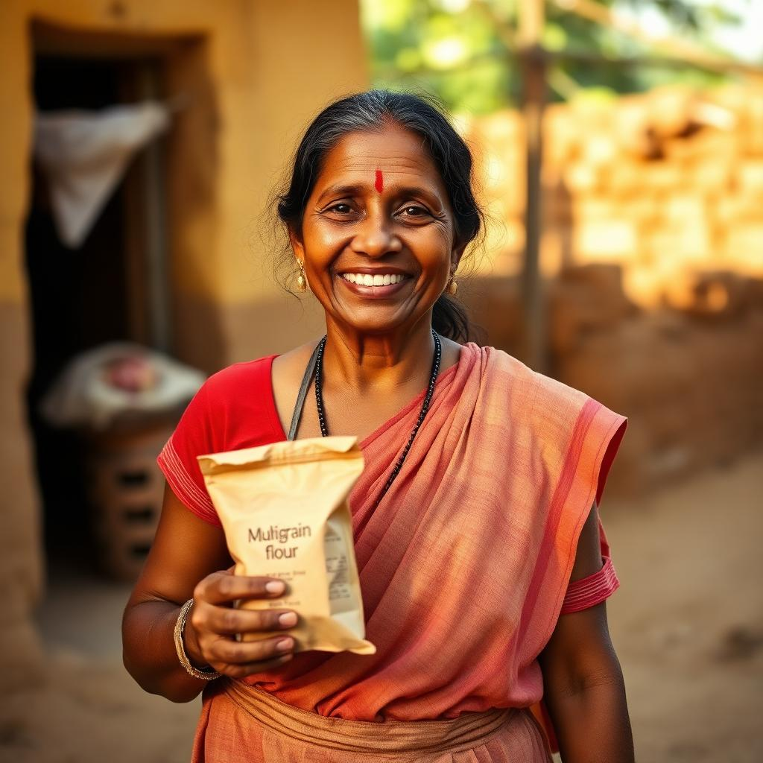
Social Impact & Awareness
Direct benefits to community
Creates local employment (2 persons / unit)
Reduces anaemia & malnutrition in women & children
Uses locally grown millets → supports farmers
Low-cost alternative to packaged “health flours”
Awareness plan
1 workshop per month in 5 villages
Demonstrate “₹5 roti = complete protein”
Partner with ASHA workers for pregnant women
“ Healthy family + steady income = real empowerment. ”
Nutri-Mix • Ragi + Bajra + Maize (50:30:20)
9 / 10

Slide 10
Conclusion & Next Steps
Summary
Next Steps
50:30:20 Ragi-Bajra-Maize → nutritionally superior & low cost
Stone milling preserves nutrients & natural oils
Start with ₹ 75 k → break even in 5 months
Daily nutrition + monthly income for rural women
Register as SHG micro-enterprise
Apply for NABARD / KVIC millet subsidy (up to 40%)
Conduct first 10 kg trial batch
Get FSSAI basic licence (₹ 2,000 – 3,000)
Supply to local ICDS centres
“ Small mill, big impact — from grain to gain. ”
Nutri-Mix • Ragi + Bajra + Maize (50:30:20)
10 / 10

